Slide 1
Clustering model for Saudi Arabia cities according to its population, Covid 19 cases and total of hospitals
Capstone Project - The Battle of Neighborhoods (Week 2)
Abdulwahed Salam

Slide 2
Introduction
Dataset Description
Analysis
Model
Experiments and Results
Acknowledgment
Conclusion and Future Work
Outlines

Slide 3
Introduction
Saudi Arabic is a country located in middle east. it consists of many states and each state consist of many cities. KSA play a major role to control the covid 19 epidemic. Nowadays, the total number of cases around 250 up to 350. Now it is time of getting the vaccine and distributed to all people in different locations. As we know the vaccine is limited and to distributed it fairly is important. we have many cities with different features. Based on that we have to build a model to cluster the cities. Also, the vaccine needs to be store in specific conditions. one of them is cold and must to be minus 85. KSA like many countries, there are small cities or region does not have hospital and we want to consider this issue.

Slide 4
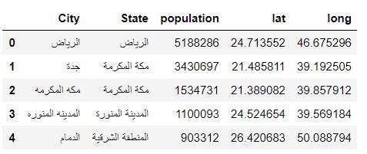
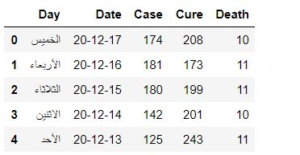
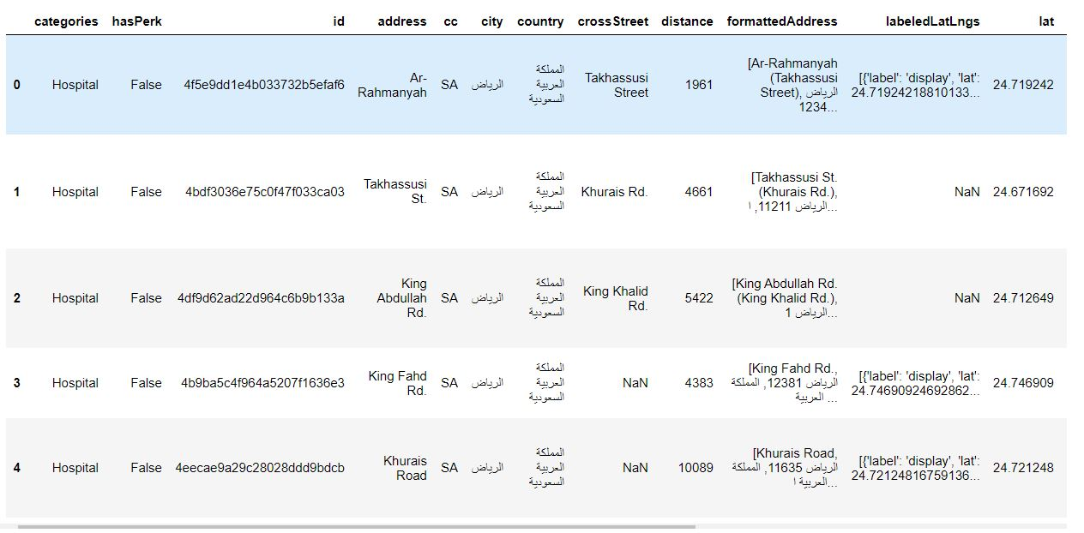
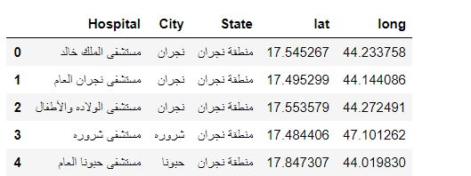
Dataset
Daily cases of covid 19 in Saudi Arabia
Covid 19 Cases according to KSA Cities
KSA Cities Hospital according to Wiki Data
Hospital information according to Foursquare API

Slide 5

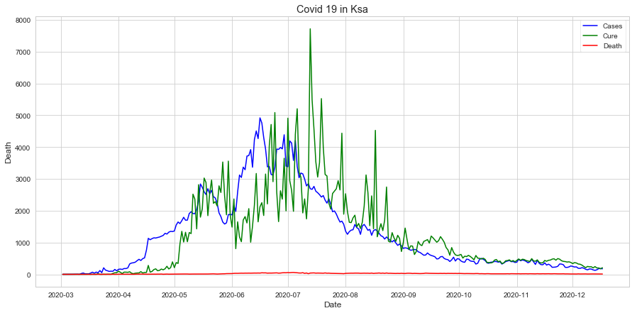
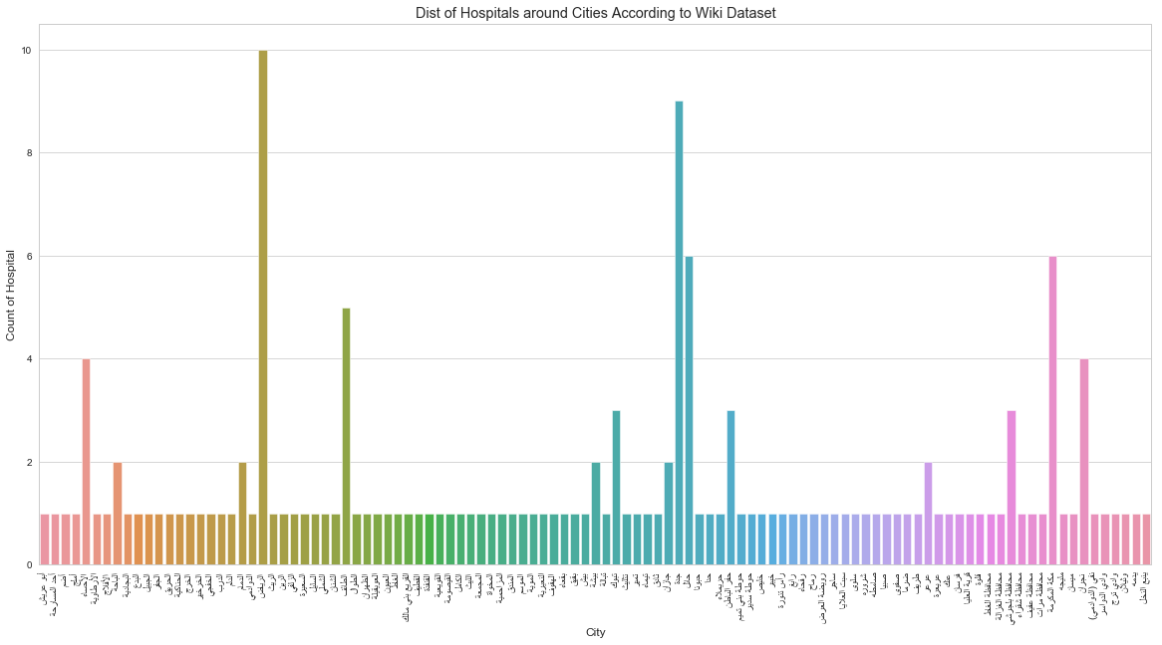
Analysis

Slide 6
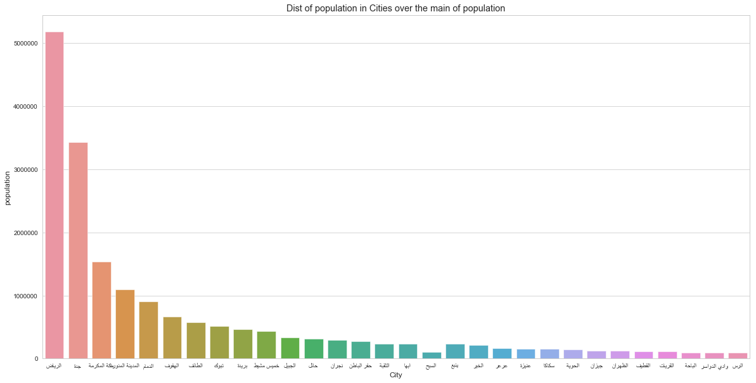
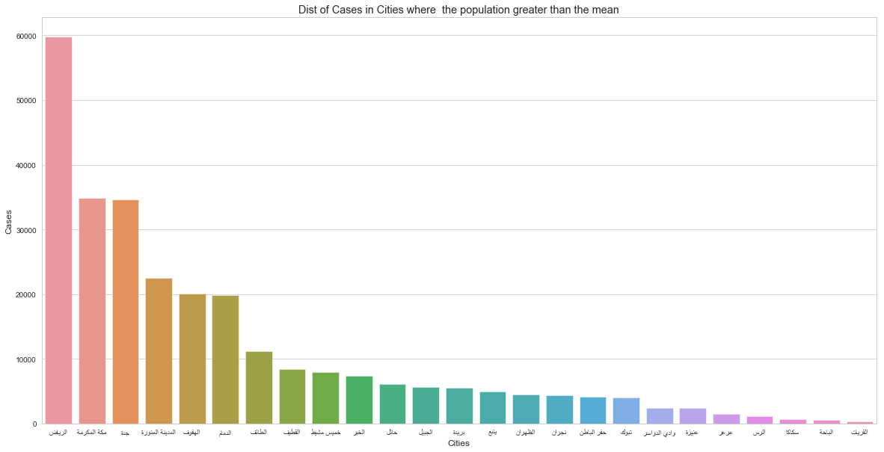
Analysis

Slide 7
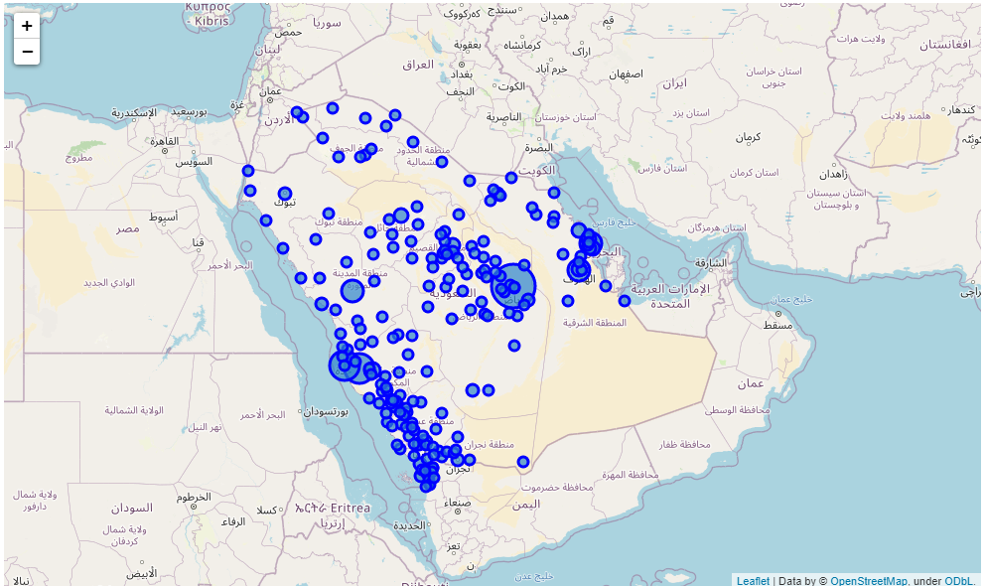
Analysis

Slide 8
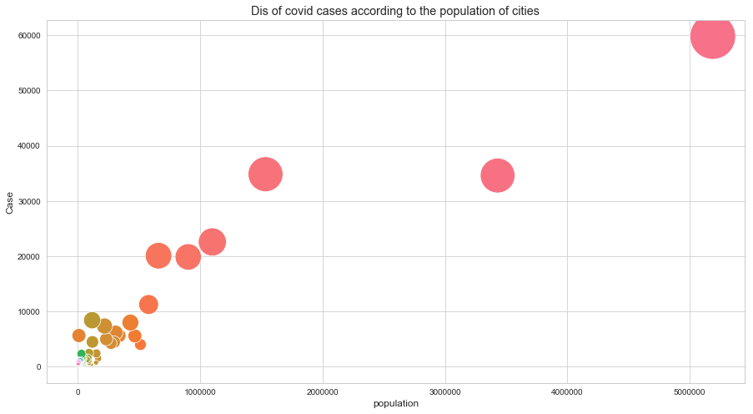
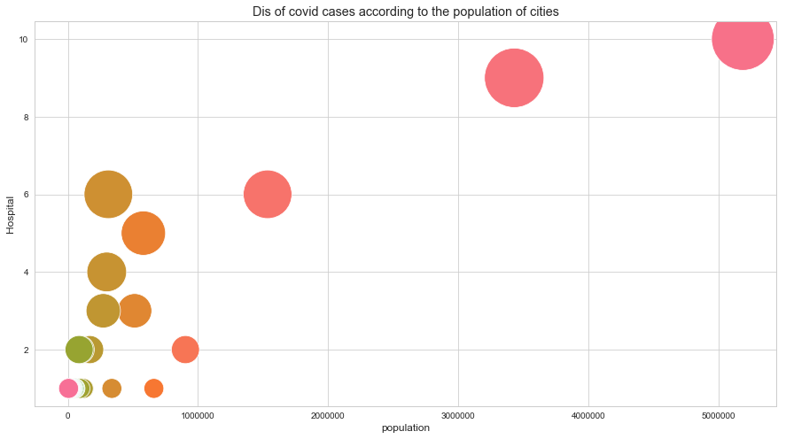
Analysis

Slide 9
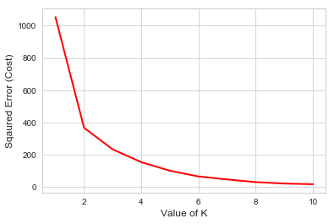
Proposed Model
We use Kmean cluster method to do that. It depends of the three different inputs Covid 19 Cases, number of hospitals and population.
We set the parameters of the Kmean model as follow:
Init:k-means++
n_clusters:4
n_init:12

Slide 10
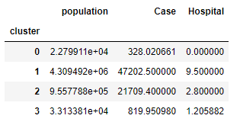
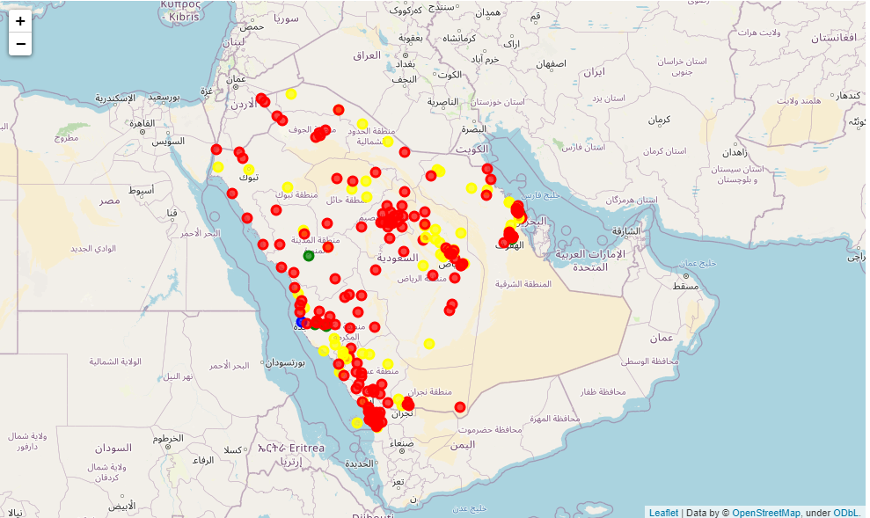
Experiments and Results
The mean of input parameters according to each cluster
Cluster | Number
0 | 242
1 | 2
2 | 5
3 | 102
Distribution of Clusters

Slide 11

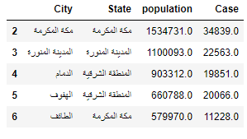
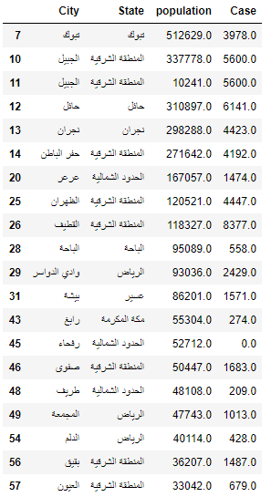
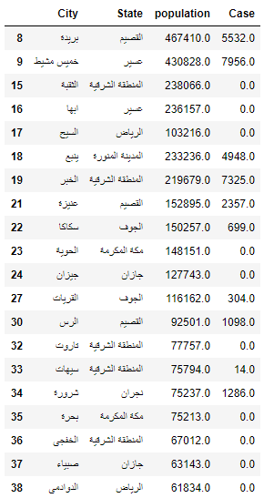
Experiments and Results
Cluster 1 information
Cluster 2 information
Top 20 of cluster 3
Top 20 of cluster 0

Slide 12
Conclusion and Future Work
In this work, I analyzed the Covid 19 of Saudi Arabia and the situation. Also, I analyze and show how Saudi Arabia control the epidemic. In this study we collect the data from many resources like ministries, Wiki, foursquare api and, etc. we combine the data and manipulate it and fill it with required data using different python libraries like geopy, foursquare and Beautiful Soup libraries. Finally, we build a cluster model using Kmean algorithm and set its parameters in correct way. The input data of the model were population, Covid 19 cases and number of hospitals. The mean reason of this study is to help Stakeholders to distribute the vacancies to the people in fairly way.
Future work
I plan to build a model of classification algorithm to help the authorities to give priorities to people according to the people in need more than authors according to the study of the affection of people.

Slide 13
Acknowledgment
Thanks to IBM for their great Course

